Slide 1


Food Delivery Analysis Dashboard
An executive-level analysis of logistic bottlenecks, customer satisfaction scores, and revenue distributions using Power BI Desktop solutions.
Prepared by M. HUSAIN NAGORI,ASMA SHAHBAZ SHAIKH,M AZHAR SUHAIL NURSUMAR
Technology Stack Power BI Desktop & Python ETL

Slide 2


Objectives & Approach
Primary Project Objectives
Target Outcomes
Develop an automated, interactive diagnostic interface that consolidates multiple transactional segments to replace slow, error-prone spreadsheets.
Highlight delivery latency hotspots across regions, pinpoint low-rated kitchen partners, and identify high-revenue food segments to maximize platform margins.
Track critical key performance metrics such as order speed, rating distributions, and regional operational performance parameters across the system.
Empower administrative dispatch teams to coordinate real-time courier adjustments using centralized business dashboards.

Slide 3
Phase 1: Data Blueprint
Establishing the structural constraints, cleaning pipelines, and calculations that turn raw transactional tables into dynamic dashboards.

Slide 4






Operational Friction Points
The Scale Barrier
Information Gaps
Revenue Friction
Manually tracking thousands of orders across scattered cities obscures latency problems, delaying logistics teams from correcting dispatch bottlenecks.
Important factors like customer rating shifts, order cancellations, and payment method patterns remain hidden within raw server logs.
Failing to identify late-dispatch patterns and low-performing menus causes customer churn and lost order value.

Slide 5


Dataset Schema Overview
Transactional Scope
Core Field Definitions
The analytics matrix spans 800 transaction records, tracking operational activities across 8 metropolitan cities and 40 unique restaurant partners.
Fulfillment Layers: Order ID, Order Date, Customer ID, City, Order Status
Merchant Metrics: Restaurant Name, Food Category, Payment Method
This balances numeric logistical performance indicators with categorized food order parameters for highly precise filtering.
Performance Data: Order Value (INR), Delivery Time (Mins), Customer Rating (1-5)

Slide 6
Power Query Preprocessing
Null & Blank Management: Identified 124 blank records in `Delivery Time` and 236 in `Rating`. Analyzed and confirmed these map to cancelled/pending orders; adjusted logic to avoid distorting metrics.
Date-Time Normalization: Converted textual date logs into active system date types, enabling smooth month-over-month trend modeling.
Unique Record Auditing: Applied strict duplicate filters on Order IDs, verifying exactly 800 unique transactions across all locations.
Outlier Verification: Isolated extreme log entries (e.g., zero-minute dispatches) to ensure precise dashboard averages.

Slide 7


Calculations & Core DAX
Technical Dax Implementation
Dynamic KPI displays and performance tracking cards run on optimized, real-time DAX formulas:
₹648.7k
Total Revenue = SUM(Dataset[Order Value])
Operational growth rates compare current performance to previous baselines using this mathematical structure:
Platform Gross Revenue (GMV)

Slide 8
Phase 2: Visual Insights
Exploring operational trends, delivery latencies, and transaction values across different food categories and regions.

Slide 9


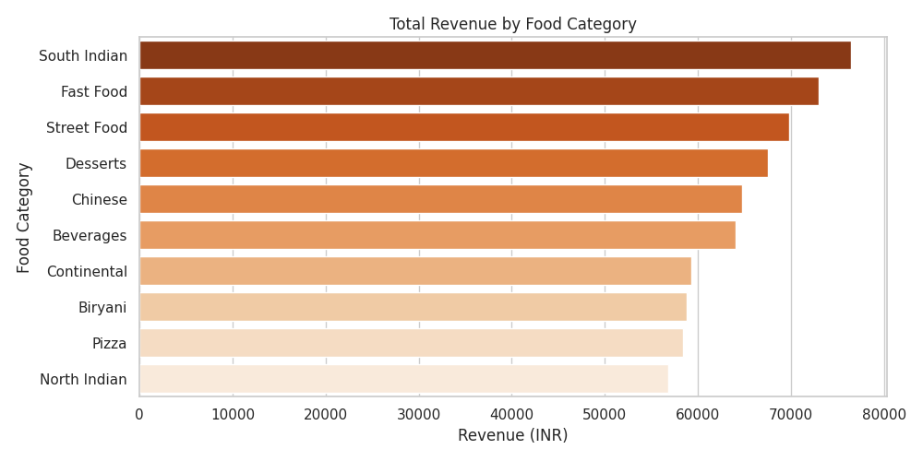
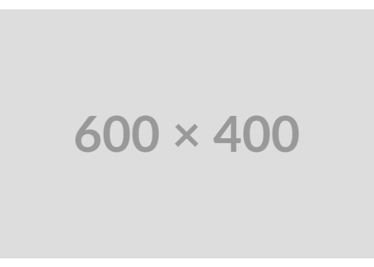
Revenue by Food Category
South Indian Cuisines Lead
The platform's primary revenue engine is South Indian food, generating over ₹76,000, closely followed by Fast Food and Street Food.
In contrast, traditional North Indian and Pizza categories sit at the lower end of transactional value, highlighting clear opportunities to optimize menu partnerships.

Slide 10
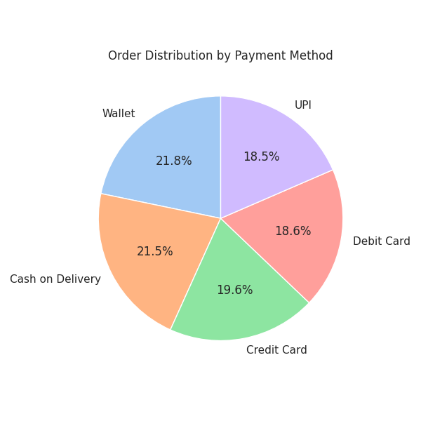
Payment Method Preferences
Balanced Payment Channels
Customer payments are distributed highly evenly, showing no single dominant channel across the system.
Digital Wallets lead at 21.8%, with Cash on Delivery (COD) close behind at 21.5%. UPI and Credit cards each capture 18-19%, requiring the platform to support all payment integrations equally.

Slide 11
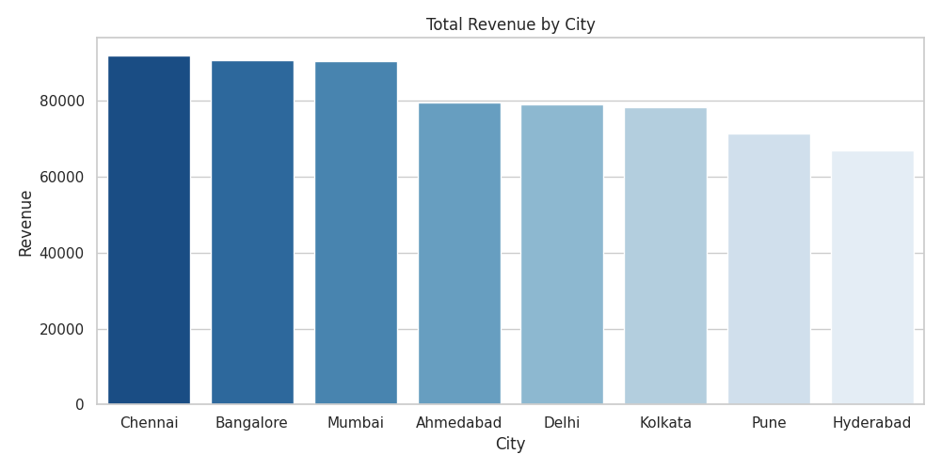
Regional Revenue Analysis
Metropolitan Revenue Clusters
Chennai and Bangalore lead regional sales performance, with each city contributing over ₹90,000 in gross revenue.
Hyderabad shows the lowest performance, capturing under ₹67,000. This indicates a clear need for targeted local promotions to expand market share.

Slide 12
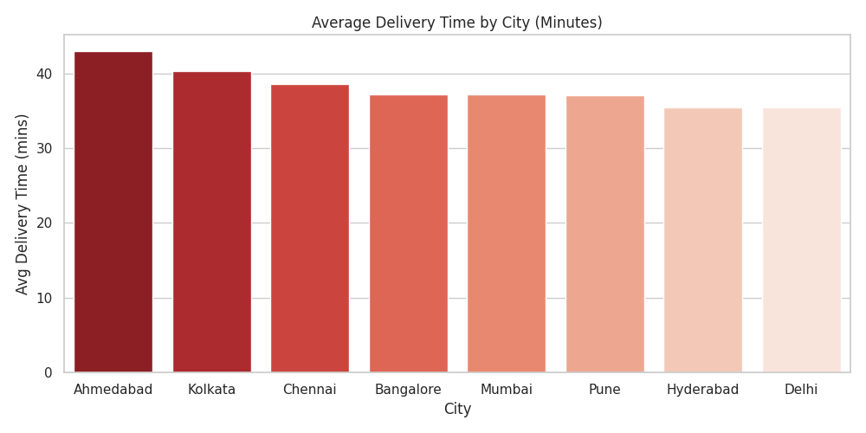
Average Delivery Duration
Logistical Latency Analysis
The platform maintains a stable national average delivery time of 38 minutes, but regional latencies vary significantly.
Ahmedabad and Kolkata show the longest dispatch delays, crossing the 40-minute mark. These cities require immediate optimizations to rider density.

Slide 13
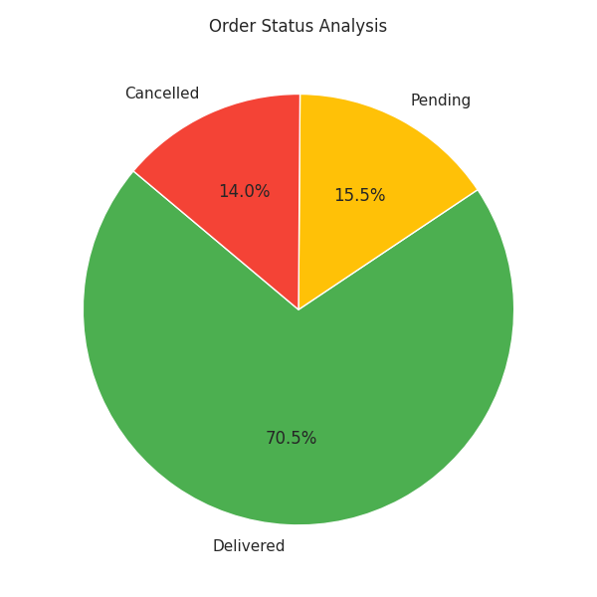
Platform Fulfillment Status
Fulfillment Health Metric
While the 70.5% delivered rate is stable, the 14.0% cancellation rate represents a major loss of revenue.
Additionally, 15.5% of transactions remain pending. Improving dispatch times will help convert these pending orders and reduce cancellations.

Slide 14
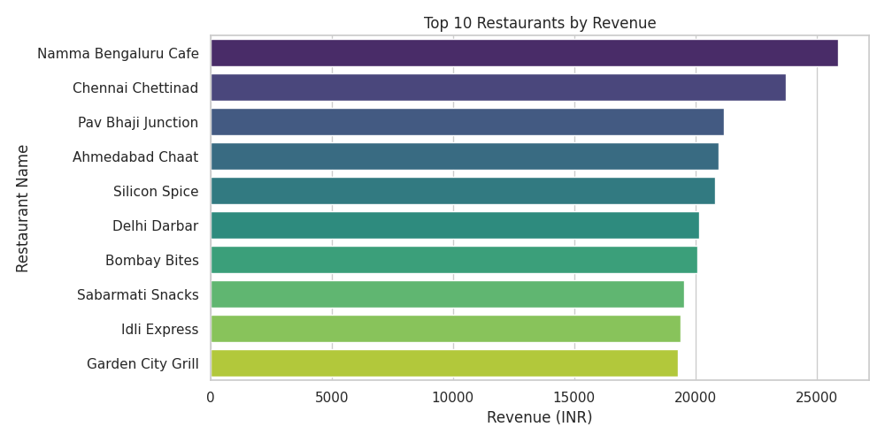
Top Performing Restaurants
Anchor Revenue Partners
Namma Bengaluru Cafe and Chennai Chettinad are the platform's highest-performing merchants, each contributing over ₹23,000.
The top 10 merchants are highly competitive, with each generating around ₹20,000. This highlights the importance of retaining these key restaurant relationships.

Slide 15


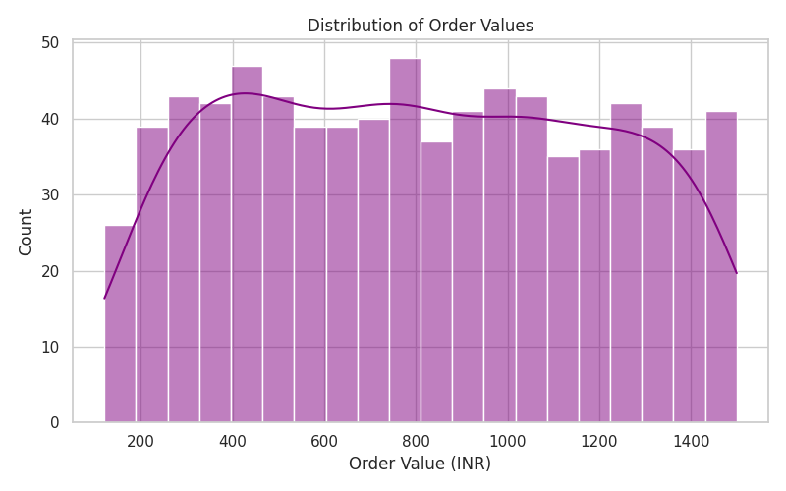
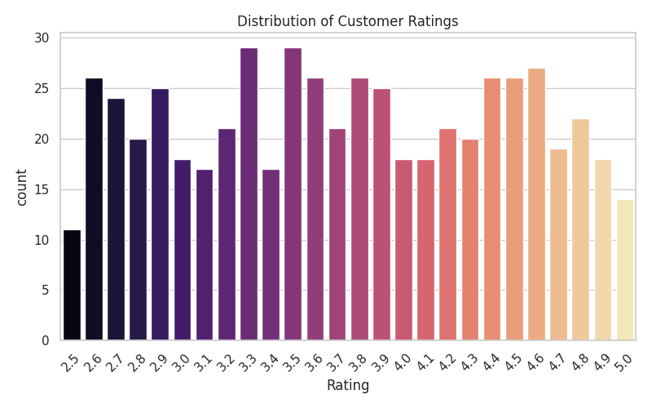


Value & Quality Distribution
Order Value Spread: Shows highly consistent transaction patterns from ₹200 to ₹1400, reflecting a healthy balance of single and group orders.
Customer Ratings: Most ratings group around the 3.3 and 3.5 marks. High-volume partners should be optimized to lift these scores toward the 4.5+ range.

